Slide 1
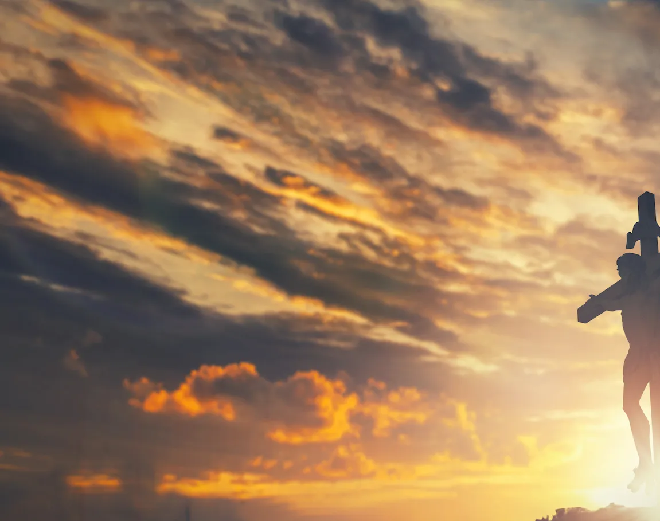
Yet Not I but Through Christ In Me

Slide 2
C F C F
C C F
What gift of grace is Jesus my redeemer
C Am G
There is no more for heaven now to give
C F
He is my joy, my righteousness, and freedom
C G C
My steadfast love, my deep and boundless peace

Slide 3
F C
To this I hold, my hope is only Jesus
F C Gsus G
For my life is wholly bound to His
C Dm C F
Oh how strange and divine, I can sing all is mine,
C G C F C F
Yet not I but through Christ in me

Slide 4
C F
The night is dark, but I am not forsaken
C Am G
For by my side, the Savior, He will stay
C F
I labor on in weakness and rejoicing
C G Csus C
For in my need, His power is displayed

Slide 5
F C
To this I hold, my Shepherd will defend me
F C Gsus G
Through the deepest valley He will lead
C Dm C F
Oh the night has been won, and I shall overcome
C G C F C F
Yet not I but through Christ in me

Slide 6
C F
No fate I dread, I know I am forgiven
C Am G
The future sure, the price it has been paid
C F
For Jesus bled and suffered for my pardon
C G Csus C
And He was raised to overthrow the grave

Slide 7
F C
To this I hold, my sin has been defeated
F C Gsus G
Jesus now and ever is my plea
C Dm C F
Oh the chains are released, I can sing I am free
C G C F C F
Yet not I but through Christ in me

Slide 8
C F
With every breath I long to follow Jesus
C Am G
For He has said that He will bring me home
C F
And day by day I know He will renew me
C G Csus C
Until I stand with joy before the throne

Slide 9
F C
To this I hold, my hope is only Jesus
F C Gsus G
All the glory evermore to Him
C Dm C F
When the race is complete, still my lips shall repeat
C G C
Yet not I but through Christ in me
REPEAT

Slide 10
C Dm C F
When the race is complete, still my lips shall repeat
C G Am F
Yet not I but through Christ in me
C G Am F
Yet not I but through Christ in me
C G C F C F
Yet not I but through Christ in me
END

Slide 11
Above All

Slide 12
CAPO 3rd
G A D
Above all powers, above all Kings
G A D
Above all nature, and all created things
Bm A G D
Above all wisdom, and all the ways of man
Em A D
You were here before the world began

Slide 13
G A D
Above all kingdoms, above all thrones
G A D
Above all wonders this world has ever known
Bm A G D
Above all wealth and treasures of the earth
Em G F#
There's no way to measure what You're worth

Slide 14
D Em A D
Crucified, laid behind a stone
D Em A D
You lived to die, rejected and alone
Bm A G D
Like a rose, trampled on the ground
Em D G A D
You took the fall, and thought of me Above all

Slide 15
G A D
Above all powers, above all Kings
G A D
Above all nature, and all created things
Bm A G D
Above all wisdom, and all the ways of man
Em A D
You were here before the world began

Slide 16
G A D
Above all kingdoms, above all thrones
G A D
Above all wonders this world has ever known
Bm A G D
Above all wealth and treasures of the earth
Em G F#
There's no way to measure what You're worth

Slide 17
D Em A D
Crucified, laid behind a stone
D Em A D
You lived to die, rejected and alone
Bm A G D
Like a rose, trampled on the ground
Em D G A D
You took the fall, and thought of me Above all
Play x2

Slide 18
Bm A G D
Like a rose, trampled on the ground
Em D G A D
You took the fall, and thought of me Above all
END

Slide 19
Above All

Slide 20
CAPO 2nd
C D G
Above all powers, above all Kings
C D G
Above all nature, and all created things
Em D C G
Above all wisdom, and all the ways of man
Am D G
You were here before the world began

Slide 21
C D G
Above all kingdoms, above all thrones
C D G
Above all wonders this world has ever known
Em D C G
Above all wealth and treasures of the earth
Am C B
There's no way to measure what You're worth
To CHORUS

Slide 22
G Am D G
Crucified, laid behind a stone
G Am D G
You lived to die, rejected and alone
Em D C G
Like a rose, trampled on the ground
Am G C D G
You took the fall, and thought of me Above all
To VERSE

Slide 23
C D G
Above all powers, above all Kings
C D G
Above all nature, and all created things
Em D C G
Above all wisdom, and all the ways of man
Am D G
You were here before the world began

Slide 24
C D G
Above all kingdoms, above all thrones
C D G
Above all wonders this world has ever known
Em D C G
Above all wealth and treasures of the earth
Am C B
There's no way to measure what You're worth
To CHORUS

Slide 25
G Am D G
Crucified, laid behind a stone
G Am D G
You lived to die, rejected and alone
Em D C G
Like a rose, trampled on the ground
Am G C D G
You took the fall, and thought of me Above all
Play x2

Slide 26
Em D C G
Like a rose, trampled on the ground
Am G C D G
You took the fall, and thought of me Above all
END

Slide 27
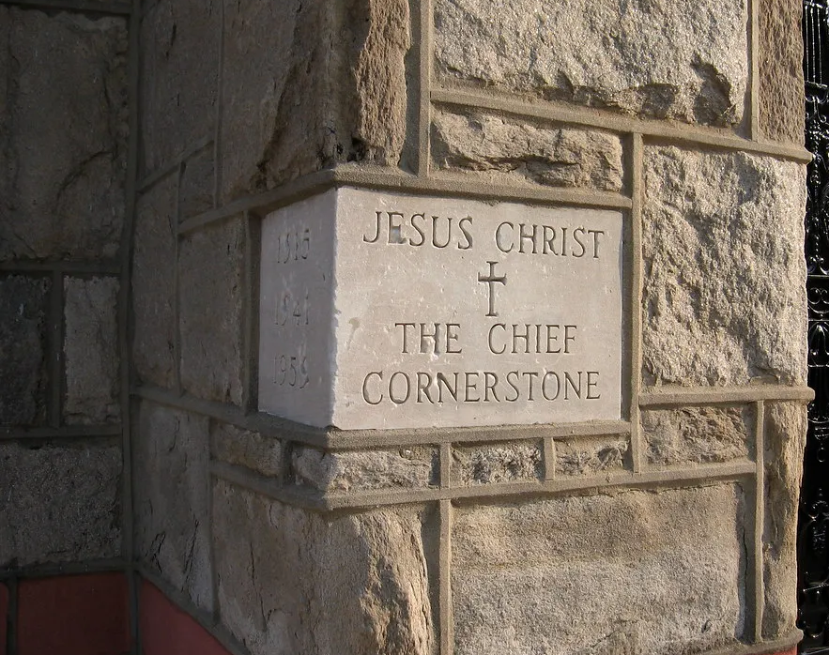
Cornerstone

Slide 28
C / Am / F / G
C
My hope is built on nothing less
F G
Than Jesus' blood and righteousness
Am Em
I dare not trust the sweetest frame
F G C
But wholly trust in Jesus' name

Slide 29
C F Am G
Christ alone, Cornerstone
C F Am G
Weak made strong in the Savior's love
C F
Through the storm
Am G C
He is Lord Lord of all

Slide 30
C
When darkness seems to hide His face
F G
I rest on His unchanging grace
Am Em
In every high and stormy gale
F G C
My anchor holds within the veil
My anchor holds within the veil

Slide 31
C F Am G
Christ alone, Cornerstone
C F Am G
Weak made strong in the Savior's love
C F
Through the storm
Am G C
He is Lord Lord of all

Slide 32
Am
He is Lord
F G
Lord of all

Slide 33
C F Am G
Christ alone, Cornerstone
C F Am G
Weak made strong in the Savior's love
C F
Through the storm
Am G C
He is Lord Lord of all

Slide 34
C
When he shall come with trumpet sound
F G
Oh may I then in Him be found
Am Em
Dressed in His righteousness alone
F G C
Faultless, stand before the throne
F / Am / G/ C
END

Slide 35
Only A Holy God

Slide 36
Am / C / F / C CAPO 2nd for Marina, Skyler
Am C F C
Who else commands all the hosts of heaven
Am C F C
Who else could make every king bow down
Am C F C
Who else can whisper and darkness trembles
F G C
Only a Holy God

Slide 37
Am C F C
What other beauty demands such praises
Am C F C
What other splendour outshines the sun
Am C F C
What other majesty rules with justice
F G C
Only a Holy God

Slide 38
Am F
Come and behold Him
C G
The One and the Only
Am F
Cry out, sing holy
C G Am
Forever a Holy God
F G
Come and worship the Holy God

Slide 39
Am C F C
What other glory consumes like fire
Am C F C
What other power can raise the dead
Am C F C
What other name remains undefeated
F G C
Only a Holy God

Slide 40
Am F
Come and behold Him
C G
The One and the Only
Am F
Cry out, sing holy
C G Am
Forever a Holy God
F G
Come and worship the Holy God
x2

Slide 41
Am C F C
Who else could rescue me from my failing
Am C F C
Who else would offer His only Son
Am C F C
Who else invites me to call Him Father
F G C
Only a Holy God

Slide 42
Am F
Come and behold Him
C G
The One and the Only
Am F
Cry out, sing holy
C G Am
Forever a Holy God
F G
Come and worship the Holy God
END

Slide 43
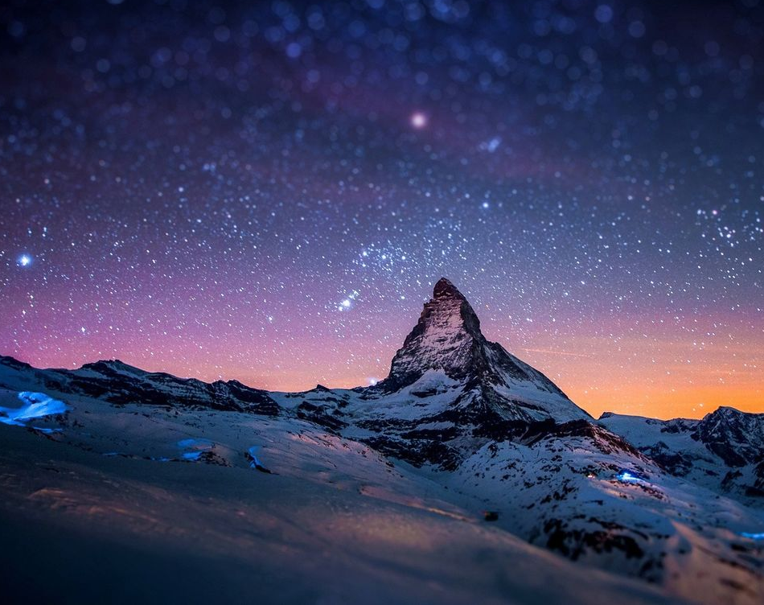
It Is Well

Slide 44
G C D G
When peace like a river attendeth my way
Em A D
When sorrows like sea billows roll
G C A D
Whatever my lot, Thou hast taught me to say
G C D G
It is well, it is well with my soul

Slide 45
G D
It is well (it is well)
D G
With my soul (with my soul)
C G D G
It is well, it is well with my soul

Slide 46
G C D G
Though Satan should buffet, though trials should come
Em A D
Let this blest assurance control
G C A D
That Christ has regarded my helpless estate
G C D G
And has shed His own blood for my soul

Slide 47
G D
It is well (it is well)
D G
With my soul (with my soul)
C G D G
It is well, it is well with my soul

Slide 48
G C D G
My sin - O, the bliss of this glorious thought
Em A D
My sin - not in part but the whole
G C A D
Is nailed to the cross and I bear it no more
G C D G
Praise the Lord, praise the Lord, O my soul

Slide 49
G D
It is well (it is well)
D G
With my soul (with my soul)
C G D G
It is well, it is well with my soul

Slide 50
G C D G
And, Lord haste the day when the faith shall be sight
Em A D
The clouds be rolled back as a scroll
G C A D
The trump shall resound and the Lord shall descend
G C D G
Even so - it is well with my soul

Slide 51
G D
It is well (it is well)
D G
With my soul (with my soul)
C G D G
It is well, it is well with my soul
END

